Slide 1
Neural Ocsillations & Altered states of Conciousness

Slide 2

. Motion On Rhythm . Everything On Rhythm

Slide 3
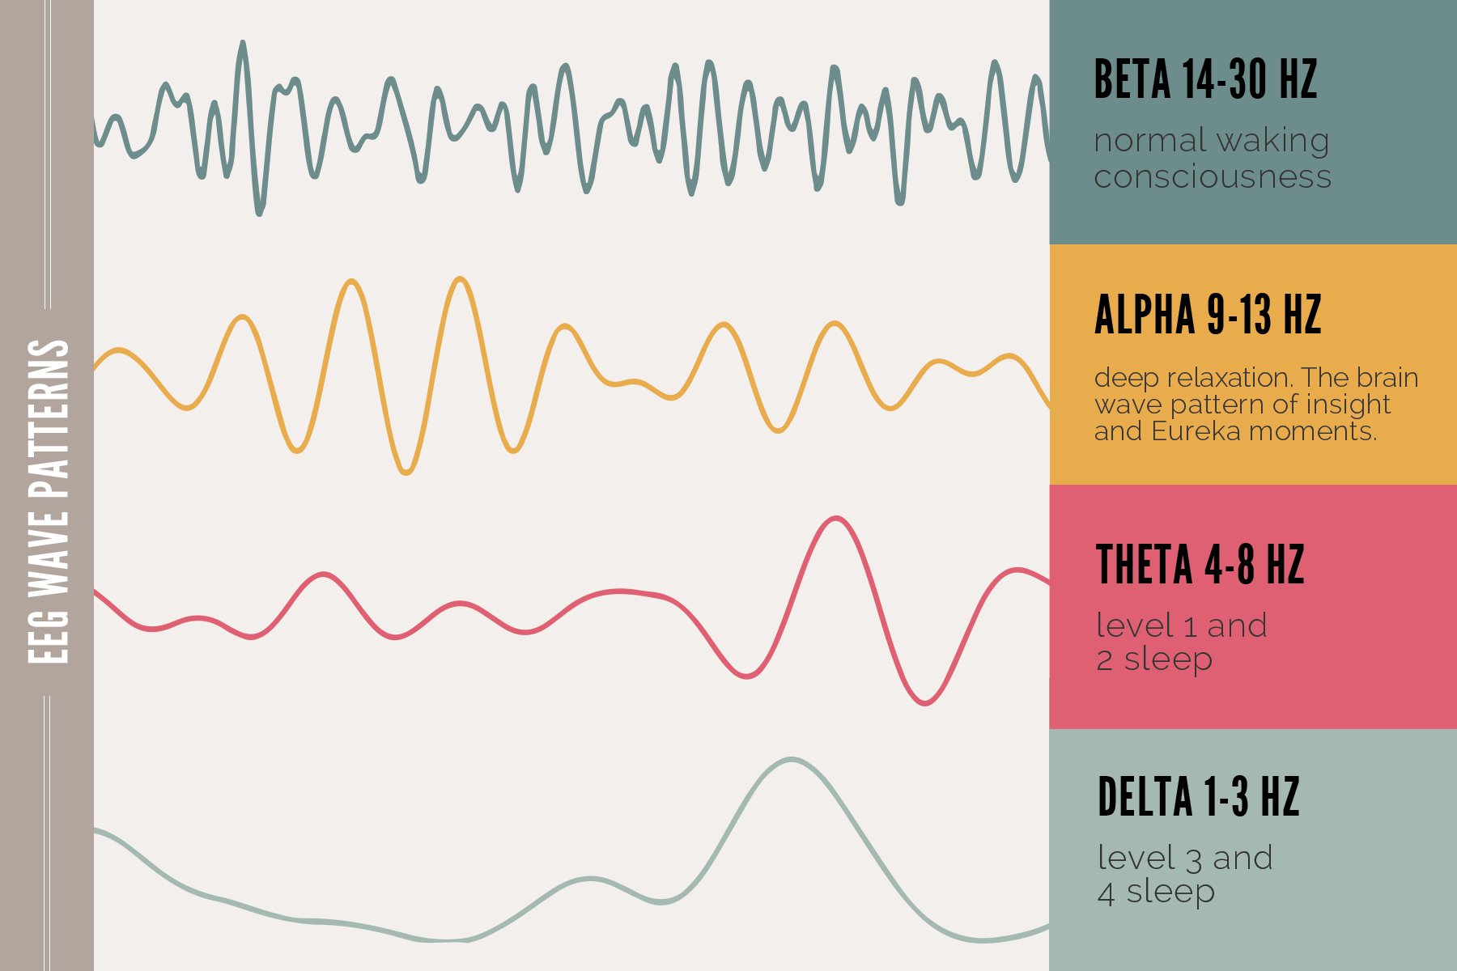
.The Deeper The Sleep, The More Resonant The Waves .Oscillations, Sleep & Long Term Memory

Slide 4
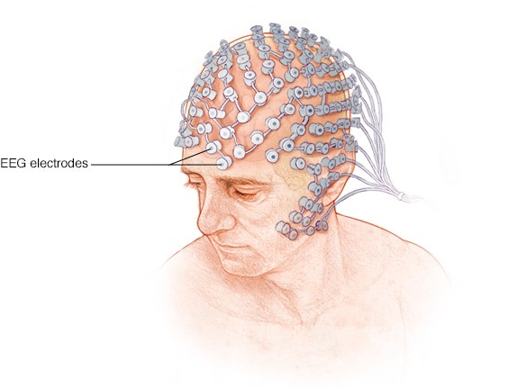
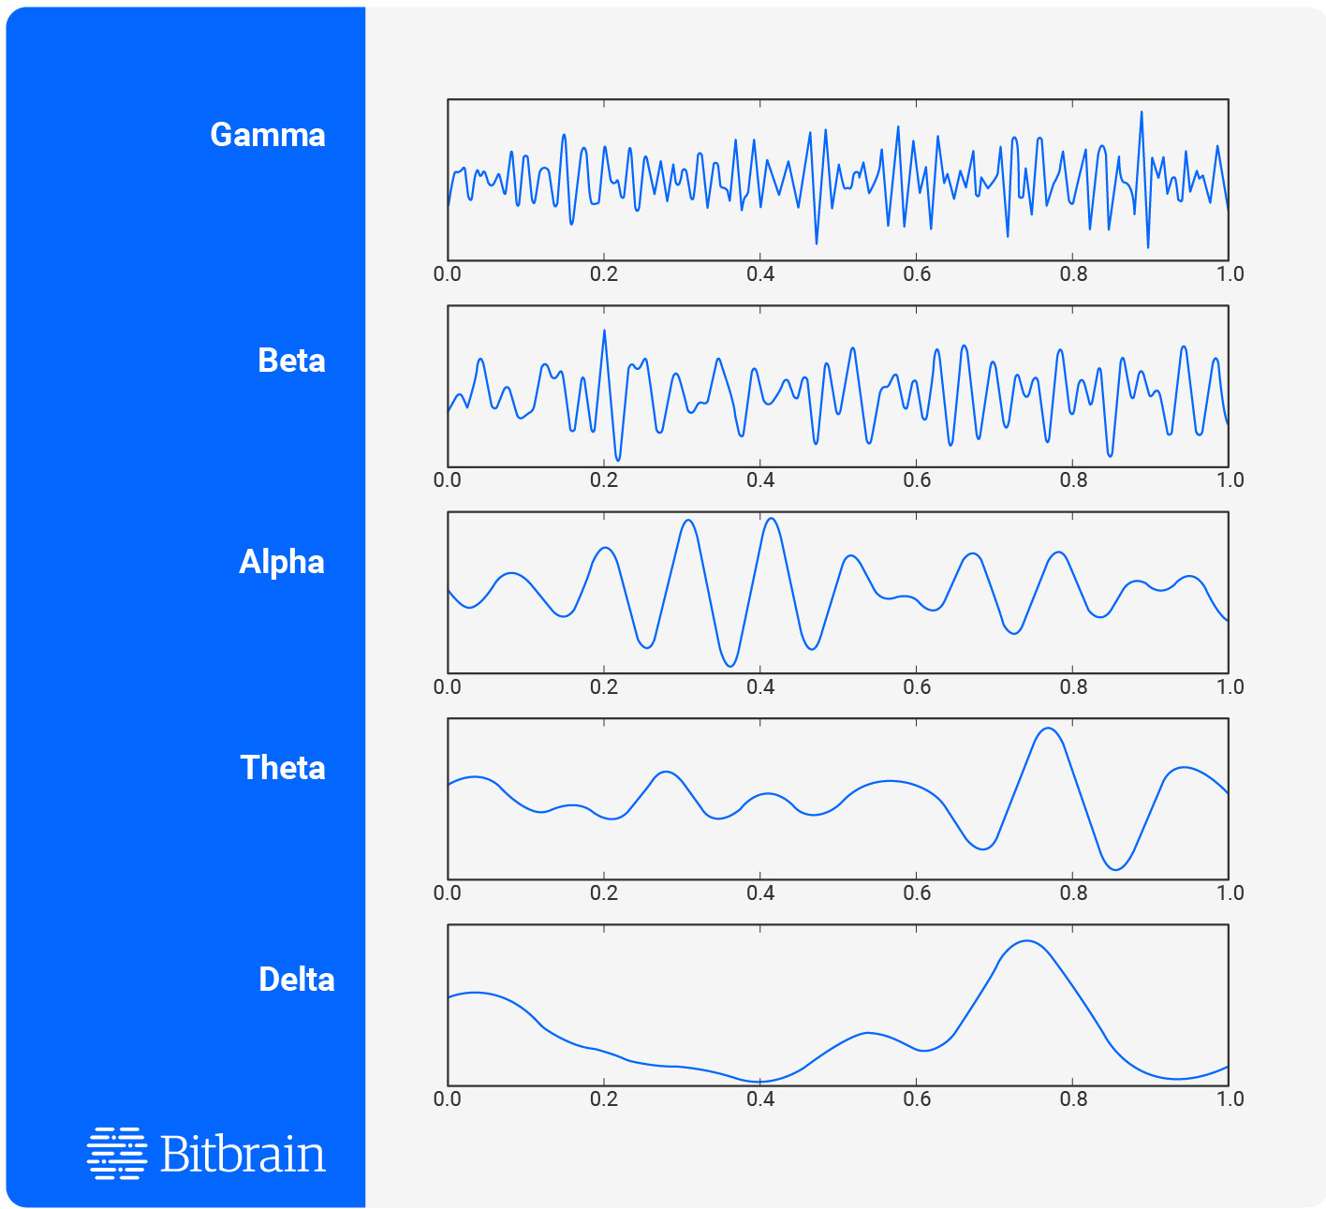
EEG
(electroencephalogram)

Slide 5
. Brain integration
. Filter Out Information
. Alter The State Of Perception

Slide 6

Delta brainwaves (1-3 Hz) are the slowest, highest amplitude brain waves, and are what we experience when we are asleep. In general, different levels of awareness are associated with dominant brainwave states.

Slide 7

Theta brainwaves (4-7 Hz) brain waves represent a day dreamy, spacey state of mind that is associated with mental inefficiency. At very slow levels, theta brain wave activity is a very relaxed state, representing the twilight zone between waking and sleep.

Slide 8

Alpha brainwaves (8-12 Hz.) are slower and larger. They are associated with a state of relaxation and represent the brain shifting into an idling gear, waiting to respond when needed. If we close our eyes and begin picturing something peaceful, there is an increase in alpha brainwaves.

Slide 9

Beta brainwaves (13 – 38 Hz) are small, faster brainwaves associated with a state of mental, intellectual activity and outwardly focused concentration. This is basically state of alertness.
High level beta twice as high comparing to mid level beta : danger zone

Slide 10

Gamma brainwaves (39 – 42 Hz) are the fastest and most subtle brain waves. Gamma rhythms modulate perception and consciousness.

Slide 11
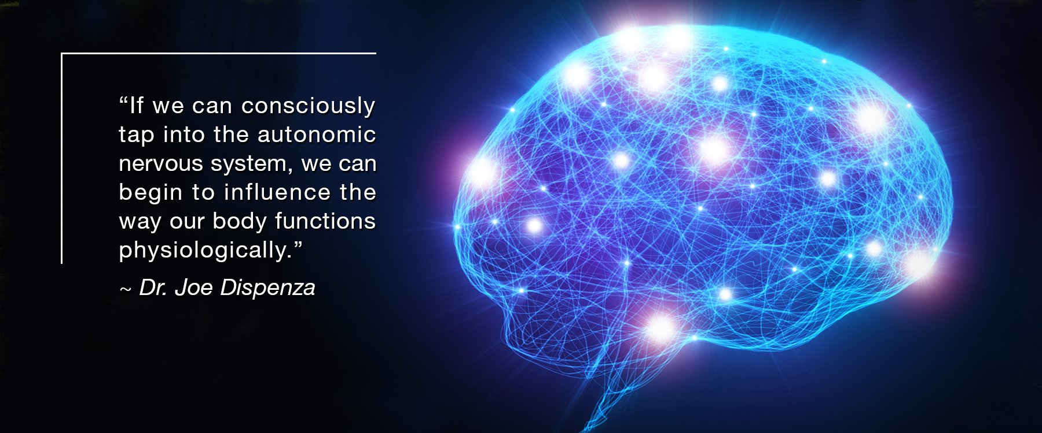

Slide 12
By different mechanisms, In different structures
. Astrocyte (sub-type of glial cells in CNS)
. Thalamo Cortical Region
. Different Neurotransmitters
. Brain Waves Themselves !
. etc.
. Also self-regulation of brain waves (neurofeedback)

Slide 13
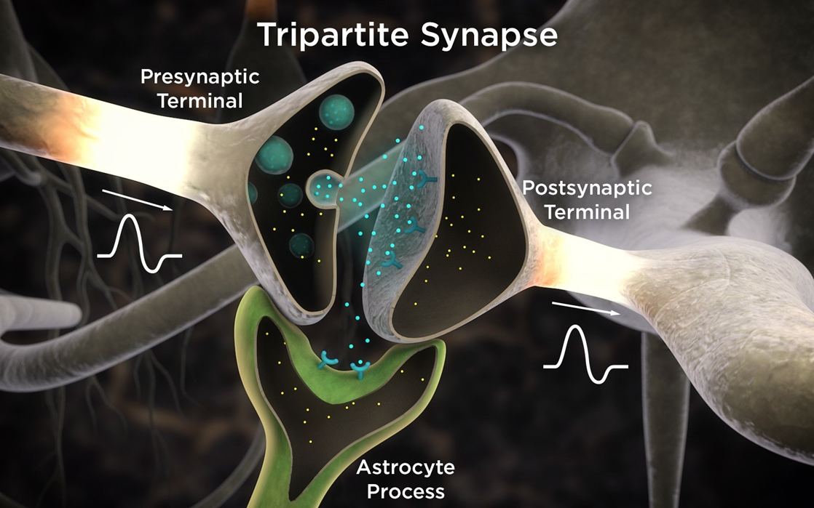
It has been postulated that at least ten distinct mechanisms are involved in the formulation of these brain waves

Slide 14
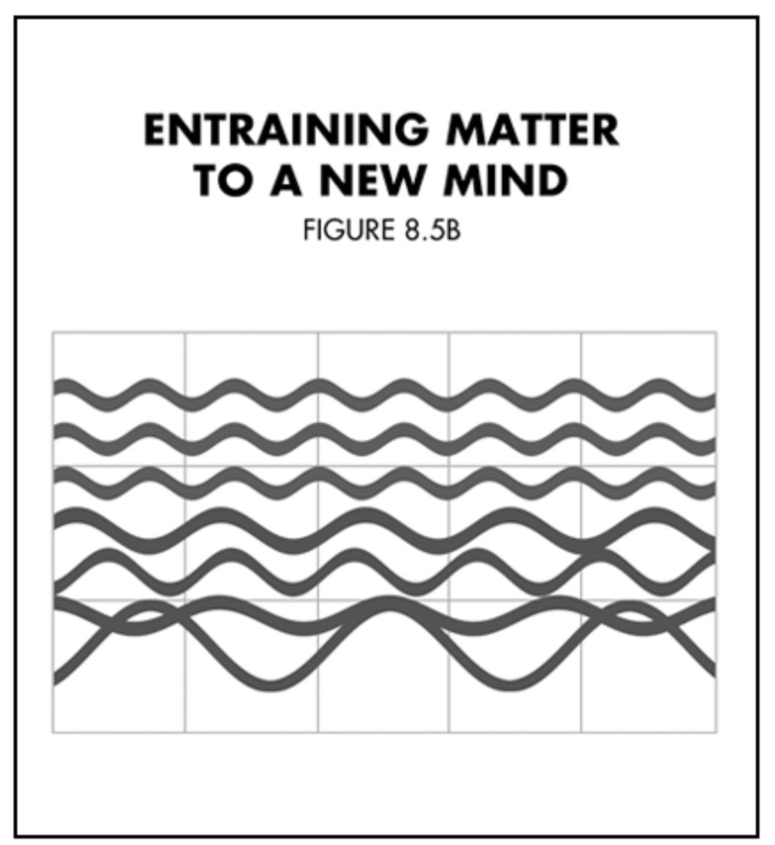
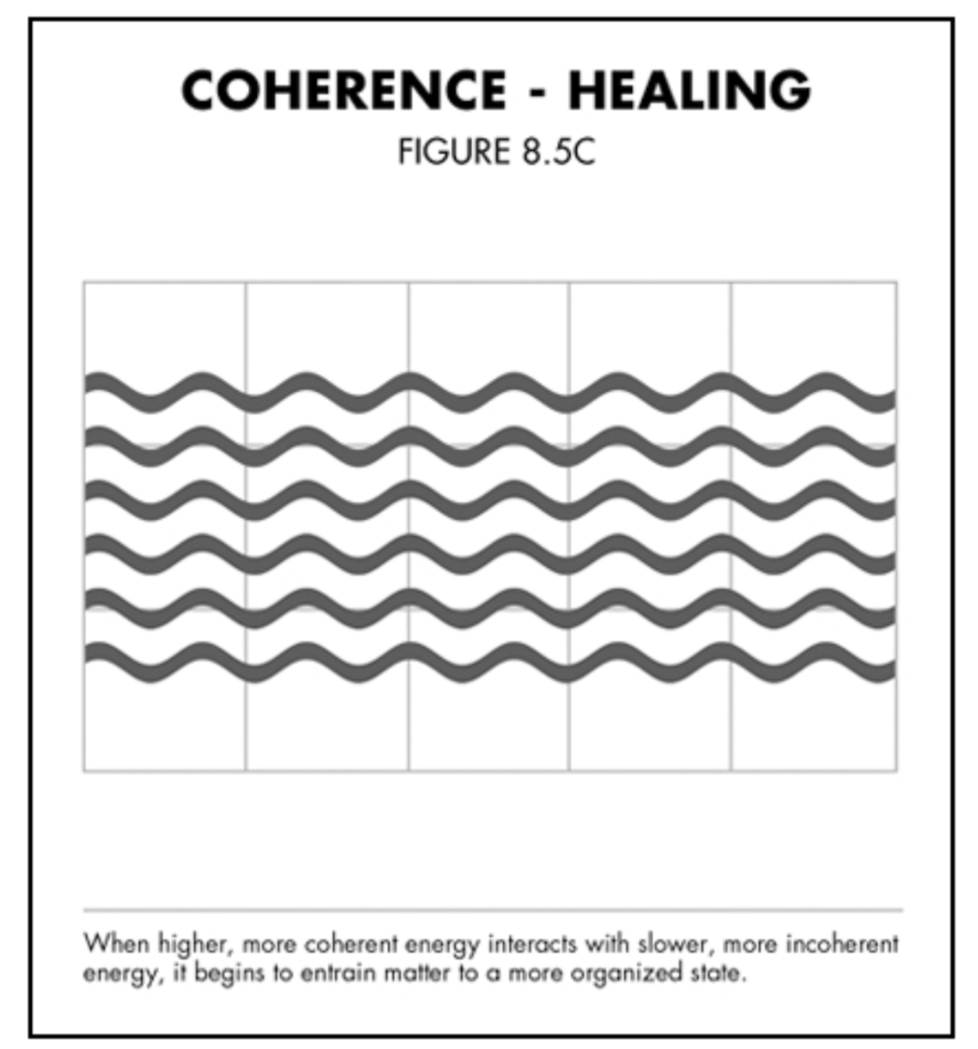
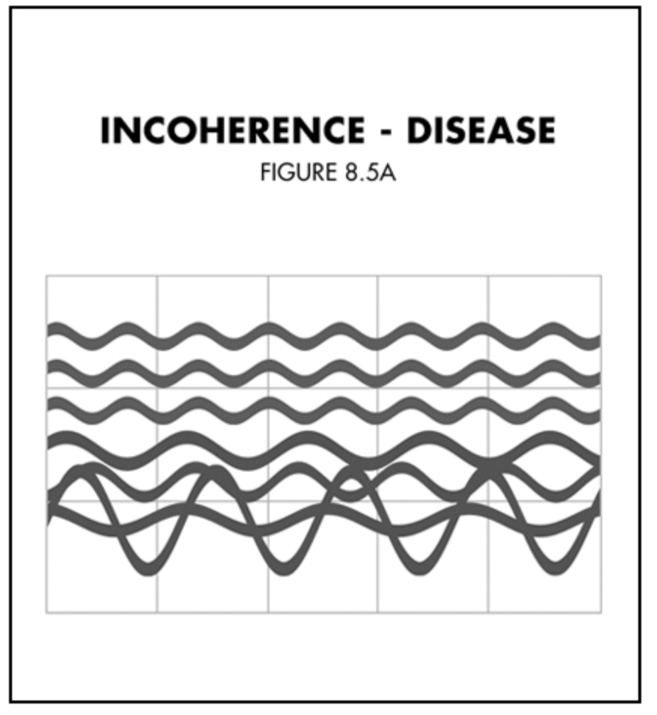
Coherence : more concentrated and synchronous. Healthy vs Unhealthy Consistent vs Abnormal
03
01
02

Slide 15
DELTA
Between birth and 2 years old
BETA
From ages 8 to 12 and onwards
D
B
predominant in children aged between 2 and 6
THETA
Between ages 5 to 8
ALPHA
T
A

Slide 16
Abstract Qs : Is the rythmic patterns a way to indruce time in mind ? As time exist only there.

Slide 18

After all maybe we need to become the child again :)

